Slide 1
HTML tags
Introduction to web design bootcamp – University of Limerick

Slide 2
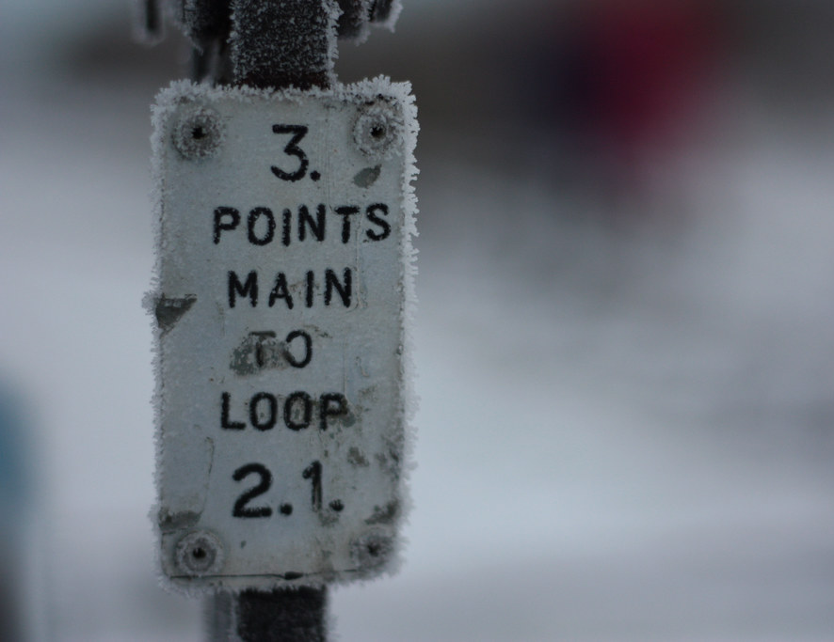
Main Points
The why of tags
The Basic Rules
Common text tags
Text Formatting
Lists and Tables
Images
Links
Other useful tags
Assignment
This Photo by Unknown Author is licensed under CC BY-SA

Slide 3
The Why of Tags
In the beginning, we only had HTML to write webpages so it had to do everything
Content
Appearance
Layout
As we’ve progressed we’ve tried to separate out the content from the appearance and layout
HTML tags are used to provide structure and meaning to the content – specific tags indicating the content has a specific purpose/meaning
CSS will control the appearance and layout (more on this later)

Slide 4
The Basic Rules
Most tags come in pairs – an opening and closing tag (we’ll mention the few exceptions as we encounter them)
<tagname> content here </tagname>
Tags come in two varieties
Block level – force next content below
Inline – do not interrupt the flow of content

Slide 5
Common Text tags
<hx> – heading tags where x is a value from 1 (largest) to 6 (smallest) – used to indicate a heading (and its importance)
<p> - paragraph tag – used to indicate paragraphs of text
<b> - bold text (replaced by <strong> tag
<i> - italics text (replaced by <em> tag)
<u> - underline text
<br /> - creates a line break – this tag has no closing tag
<hr /> - creates a horizontal rule – this tag has no closing tag

Slide 6
(Other) Text Formatting
<strike> - strike through text
<sup> - superscript text
<sub> - subscript text
<small> - small text
<big> - big text
<pre> - preformatted text (doesn’t ignore whitespace
<blockquote> - blockquote

Slide 7
Lists and tables
Lists and tables are examples of composite tags (tags that need other tags to work)
For lists we have two sets of tags
One to indicate the list type
<ol> - ordered lists
<ul> - unordered lists
The other for each of the list items
<li> list item

Slide 8
Unordered list example
<ul>
<li>Red</li>
<li>Green</li>
<li>Blue</li>
</ul>
Red
Green
Blue
Ordered list example
<ol>
<li>Red</li>
<li>Green</li>
<li>Blue</li>
</ol>
Red
Green
Blue
List examples

Slide 9
Lists and tables (cont’d)
Tables are slightly more complicated
For tables we need three sets of tags:
One to indicate a table
<table>
One for each row in your table
<tr>
One for each cell in each row
<td>

Slide 10
<table>
<tr>
<td>Colors</td>
<td>Red</td>
<td>Green</td>
<td>Blue</td>
</tr>
<tr>
<td>Cities</td>
<td>Cork</td>
<td>Limerick</td>
<td>Dublin </td>
</tr>
</table>
Table examples
Colors | Red | Green | Blue
Cities | Cork | Limerick | Dublin

Slide 11
Images
Pictures (or images or visuals – however you refer to them) are a vital part of an attractive website
We use the <img /> tag (another tag with no closing tag) to indicate an image
It requires attributes to work
Attributes are modifiers to a basic tag
We use the src attribute to indicate where the image is located
We also need to provide an alt attribute as alternate text to describe the image

Slide 12
Images src attribute
We have two ways of indicating the location of an image:
Absolute address – the full path to the file e.g. http://www.mywebsite.com/mypics/boat1.jpg
Relative address – the address relative to the page we are on
if our webpage is located in a folder called cybercamp and our picture (boat1.jpg) is located in the same folder the path would be boat1.jpg.
If it was in a sub folder called mypics then the path would be mypics/boat1.jpg

Slide 13
Links
Finally, the one things that makes the Internet a net(work) is the ability to move from one page to the next
We accomplish this using the <a> anchor tag
The anchor tag has an attribute href which tells us where clicking on the link will take us
Just like src attribute in <img> tag, can be an absolute or relative address
The content inside the <a> tag is what we can click on

Slide 14
Other useful basic tags
Other tags we’ll be using in this section that we’ll find useful are:
<div> - the division tag – used to indicate a section of the page – useful for layout
<span> - the span tag used to ‘highlight’ a piece of content – useful for CSS
Form tags – multiple tags here – used for getting user input
HTML entities – not tags but used for characters that would otherwise cause problems or cannot be easily written using the keyboard:
&copy; for the copyright character (©)
&lt; for when we actually want a < character

Slide 15
First assignment
On the following slide you will find an image of a finished webpage.
Your task is to create a website that as closely as possible matches to the webpage shown on the slide
You will need to download the image from the lesson page called boat1.jpg
You will also need the links to the two other images
Use the MDN (Mozilla Developer Network) website to find out how to add alt text and titles to images. Also how to use attributes to set the width and height of pictures.

Slide 16
